Slide 1
MINI PROJECT
IRCTC

Slide 2

IRCTC
Supervisor: K . Srinivas
Team Members:
Gattu Abhilash(2453-18-733-081)
Aila Varun(2453-18-733-063)
Thanuku Premsai(2453-18-733-111)
Sai Murali (2453-18-733-311)

Slide 3
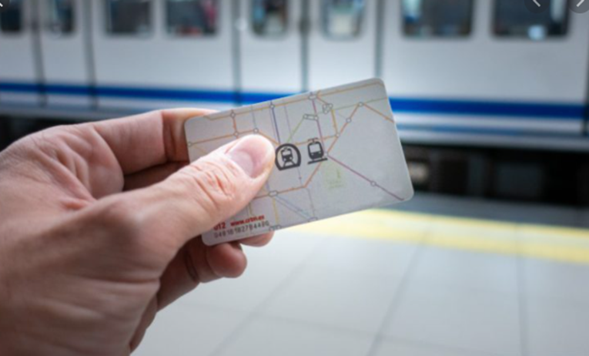
CONTENTS:
Introduction
Importance and need of your project Design
Tools and Technologies Implementation
System/User requirements Contributions
System Design
Conclusion of the Project

Slide 4
INTRODUCTION
The purpose of this project is to describe the railway reservation system, which provides the train timing details, reservation and cancellation on various types of reservation namely. In addition, This Railway reservation service will not only enhance the reservation but will also help the commuters in getting support and other real time fixes.
Confirm Reservation for confirm Seat.
Reservation against Cancellation.
Online Reservation.

Slide 5
IMPORTANCE AND NEED OF YOUR PROJECT
Before making this a real time running online reservation system, old system suffered from many of the DRAWBACKS, such as:
The existing system is highly manual involving a lot of paper work and calculation and therefore may be erroneous. This has led to inconsistency and inaccuracy in the maintenance of data.
The data, which is stored on the paper only, may be lost, stolen or destroyed due to any natural calamity of fire or water.
Existing system is sluggish and consumes a lot of time, resource etc. causing inconvenience to customers and staff.
Due to manual working, it is difficult to add, delete, update, or view the data.
Since number of passengers has increased to an uncertain multiple , it is very difficult to maintain or retrieve detailed record of passengers.
A Railway has many offices around the world, an absence of link between them all causes to a lack of miscommunication and discoordination

Slide 6
IMPORTANCE AND NEED OF YOUR PROJECT
As working on this website will require some basic computer knowledge , we classify knowledge required by the users in two basic categories:
EDUCATIONAL LEVEL: At least the user of this system should be comfortable with English Language.
TECHNICAL EXPERTISE: User should be comfortable using general-purpose applications on the computer system.

Slide 7
TOOLS AND TECHNOLOGIES
The following are the Tools and Technologies used while developing the project:
1. Google’s Dialogflow : Dialogflow is a natural language understanding platform that makes it easy to design and integrate a conversational user interface into your web application, bot, interactive voice response system, and so on. Using Dialogflow, you can provide new and engaging ways for users to interact with your product.
2. Visual Studios: Visual Studio Code is a free source-code editor made by Microsoft for Windows, Linux and macOS. Features include support for debugging, syntax highlighting, intelligent code completion, snippets, code refactoring, and embedded Git.

Slide 8
TOOLS AND TECHNOLOGIES
3. PyCharm : PyCharm is an integrated development environment (IDE) used in computer programming, specifically for the Python language. It is developed by the Czech company JetBrains. It provides code analysis, a graphical debugger, an integrated unit tester, integration with version control systems , and supports web development with Django as well as data science with Anaconda.
4. SQLite Studio: SQLite is a relational database management system (RDBMS) contained in a C library. In contrast to many other database management systems, SQLite is not a client–server database engine. Rather, it is embedded into the end program.

Slide 9
TOOLS AND TECHNOLOGIES
5. HTML : Hypertext Markup Language (HTML) is the standard markup language for documents designed to be displayed in a web browser. It can be assisted by technologies such as Cascading Style Sheets (CSS) and scripting languages such as JavaScript.
6. CSS : Cascading Style Sheets (CSS) is a style sheet language used for describing the presentation of a document written in a markup language such as HTML. CSS is a cornerstone technology of the World Wide Web, alongside HTML and JavaScript.
7. JavaScript : JavaScript often abbreviated as JS, is a programming language that conforms to the ECMAScript specification. JavaScript is high-level, often just-in-time compiled, and multi-paradigm. It has curly-bracket syntax, dynamic typing, prototype-based object-orientation, and first-class functions.

Slide 10
TOOLS AND TECHNOLOGIES
8. Python: Python is an interpreted, high-level and general-purpose programming language. Python's design philosophy emphasizes code readability with its notable use of significant indentation. Its language constructs and object-oriented approach aim to help programmers write clear, logical code for small and large-scale projects.
9. Django : Django is a Python-based free and open-source web framework that follows the model-template-views (MTV) architectural pattern. It is maintained by the Django Software Foundation (DSF), an American independent organization established as a 501(c) non-profit.
10. NodeJS : Node.js is an open-source, cross-platform, back-end JavaScript runtime environment that runs on the V8 engine and executes JavaScript code outside a web browser.

Slide 11
SYSTEM/USER REQUIREMENTS
System Requirement : For using any type of Operating System with at Least Internet Explorer Installed and having minimum of 512 kbps working LAN compulsorily.
User Requirement : After a brief study of requirements of clients the requirements of this system is given as:
1. Login Information
2. Reservation Details
3. Train Details

Slide 12
SYSTEM DESIGN
ER Diagram
Use case Diagram
Class Diagram
Sequence Diagram
Activity Diagram / State Chart Diagram / Collaboration Diagram
Component Diagram / Deployment Diagram

Slide 13
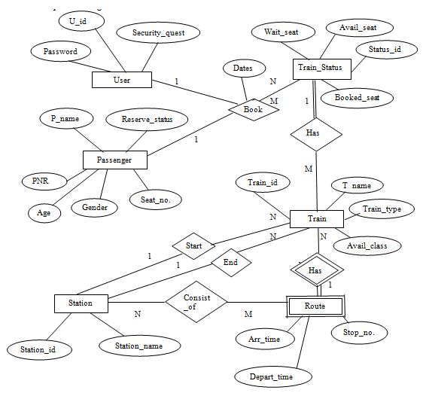
1. ER Diagram

Slide 14
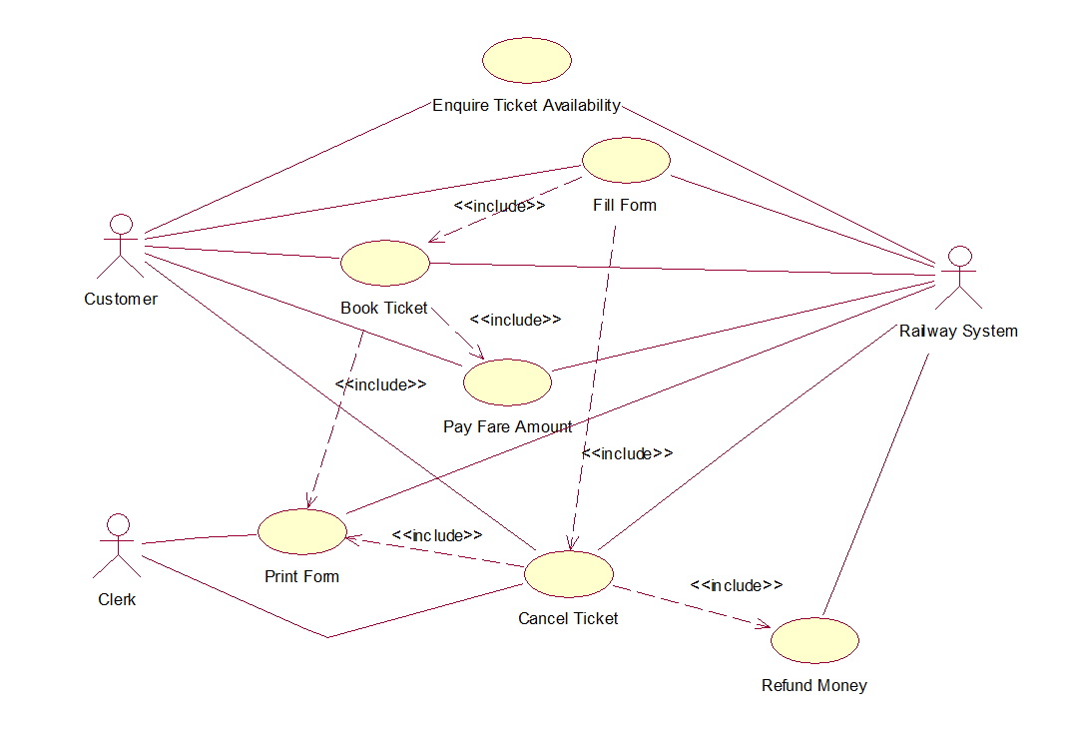
2. Use Case Diagram

Slide 15
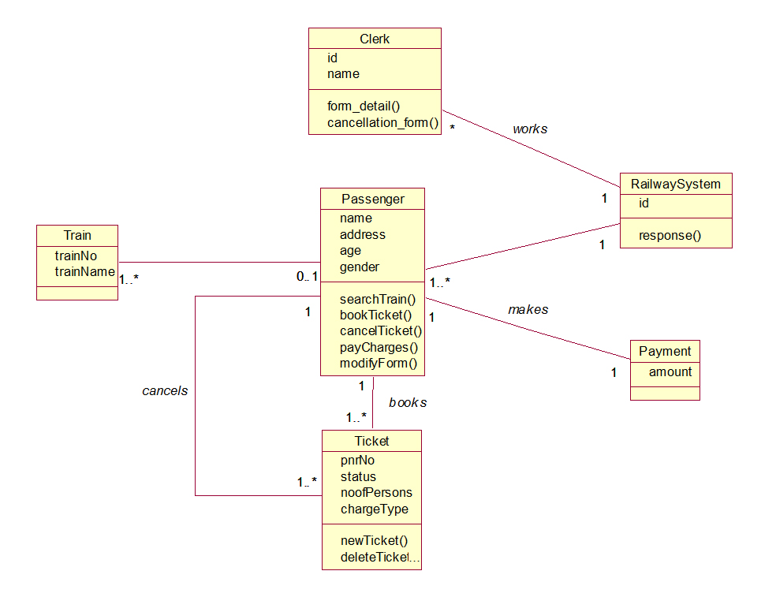
3. Class Diagram

Slide 16
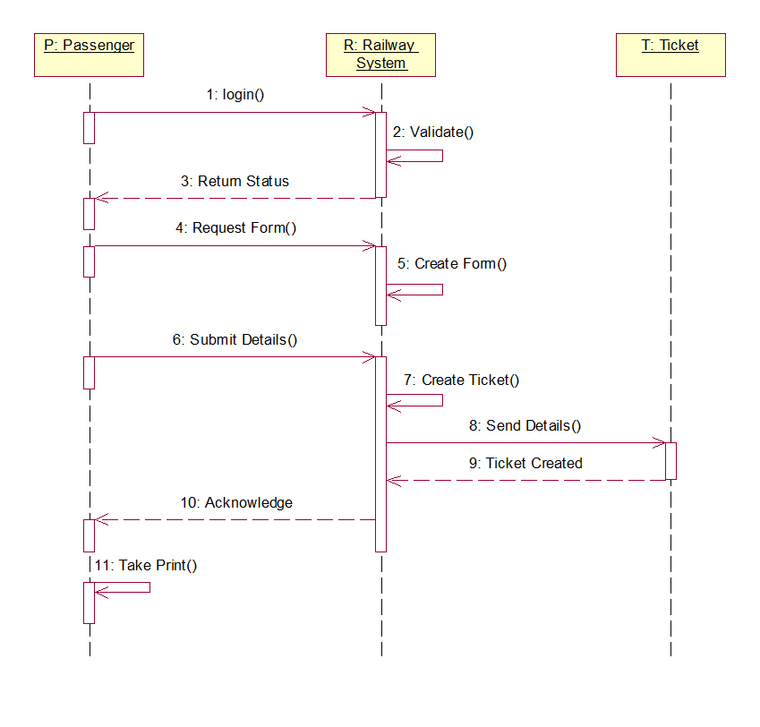
4. Sequence Diagram

Slide 17
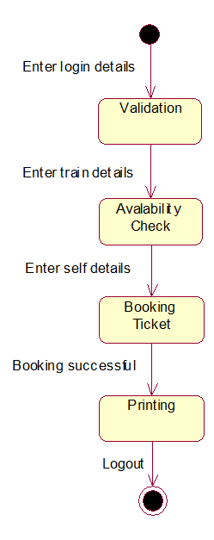
5. Activity Diagram / State Chart Diagram / Collaboration Diagram

Slide 18
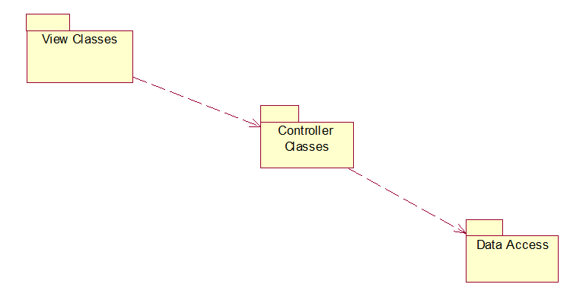
6. Component Diagram / Deployment Diagram

Slide 19
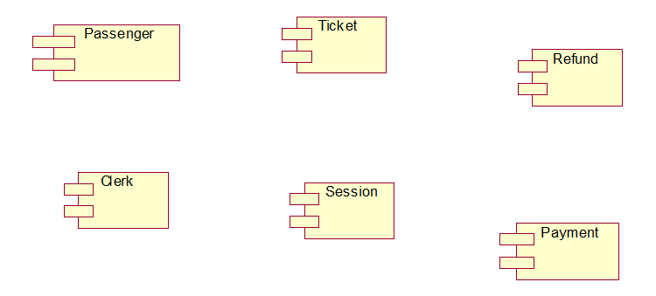
Component Diagram Controller Classes

Slide 20
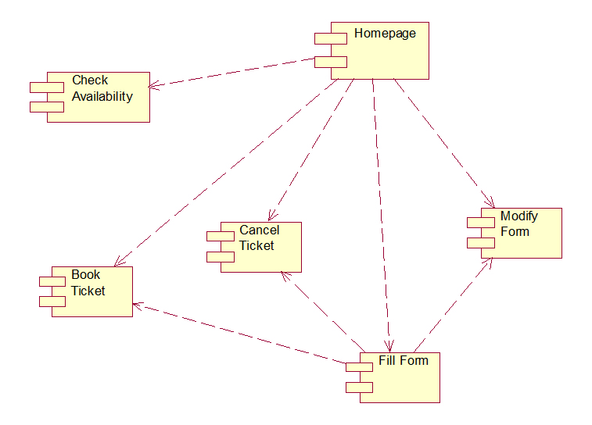
Component Diagram View Class

Slide 21
Conclusion of the Project
Through the proposed project and research, we draw a conclusion that our IRCTC project will get the train details, reservation and cancellation on various types of reservation namely
In this Project we build up a system which is useful for the customers and users for train details.

